Slide 1
Summer Internship Presentation
Aryan Ritwajeet Jha
Intern for Summer 2024
as part of
Advanced System Analytics & Modelling (ASAM)
NERC

Slide 2
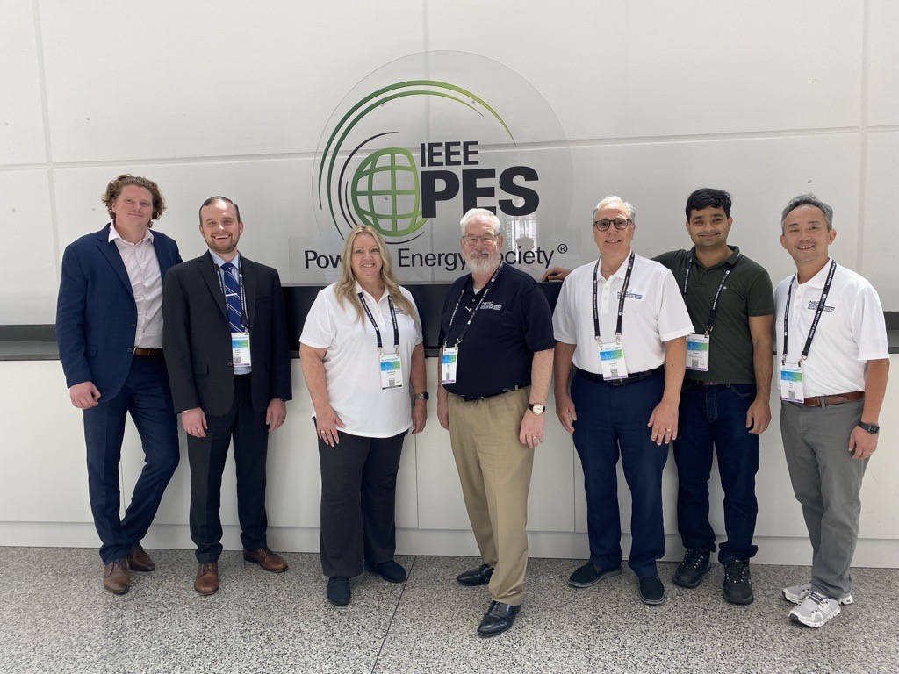


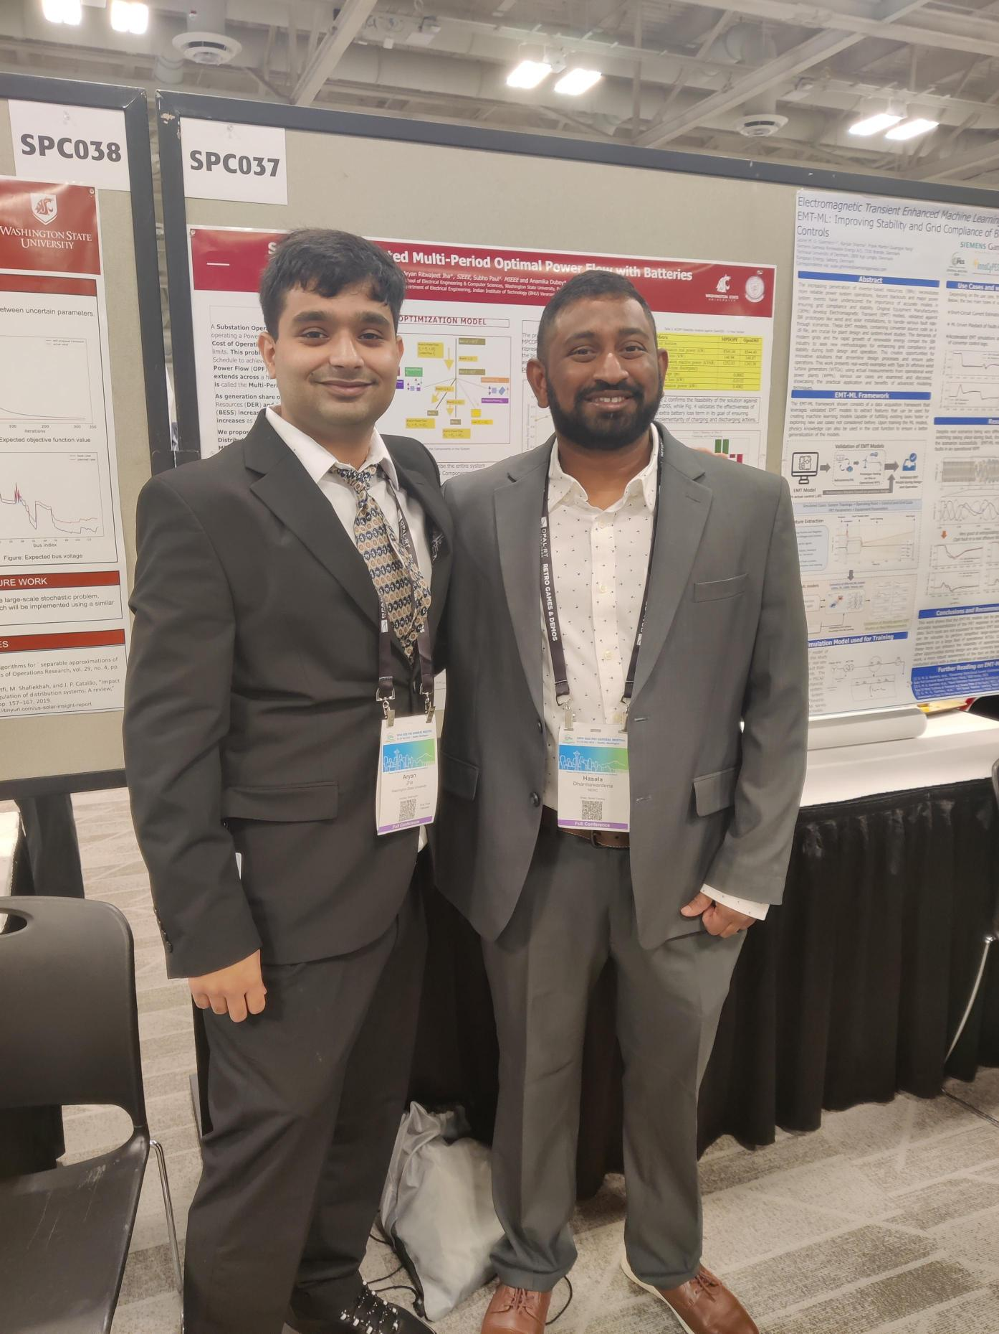
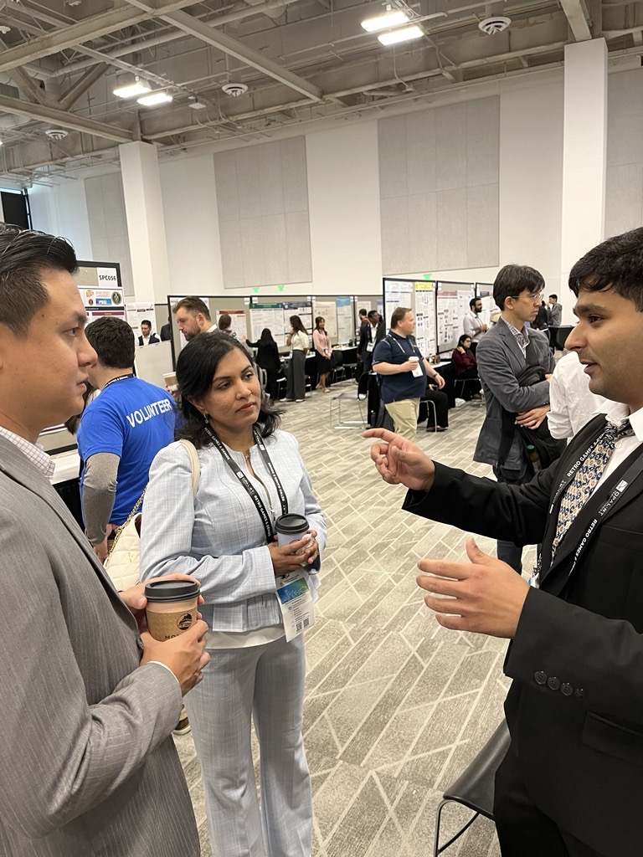


About Me
Since August $2022$: PhD ECE (Power Systems) Student at Washington State University, Pullman, WA
Previously:
Graduate EE Research Assistant at Indian Institute of Technology Delhi, India
BE EEE at Birla Institute of Technology and Science, Pilani, Rajasthan, India

Slide 3
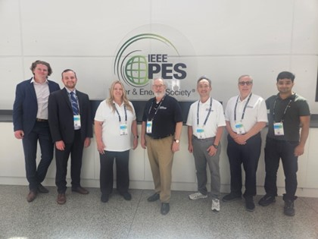

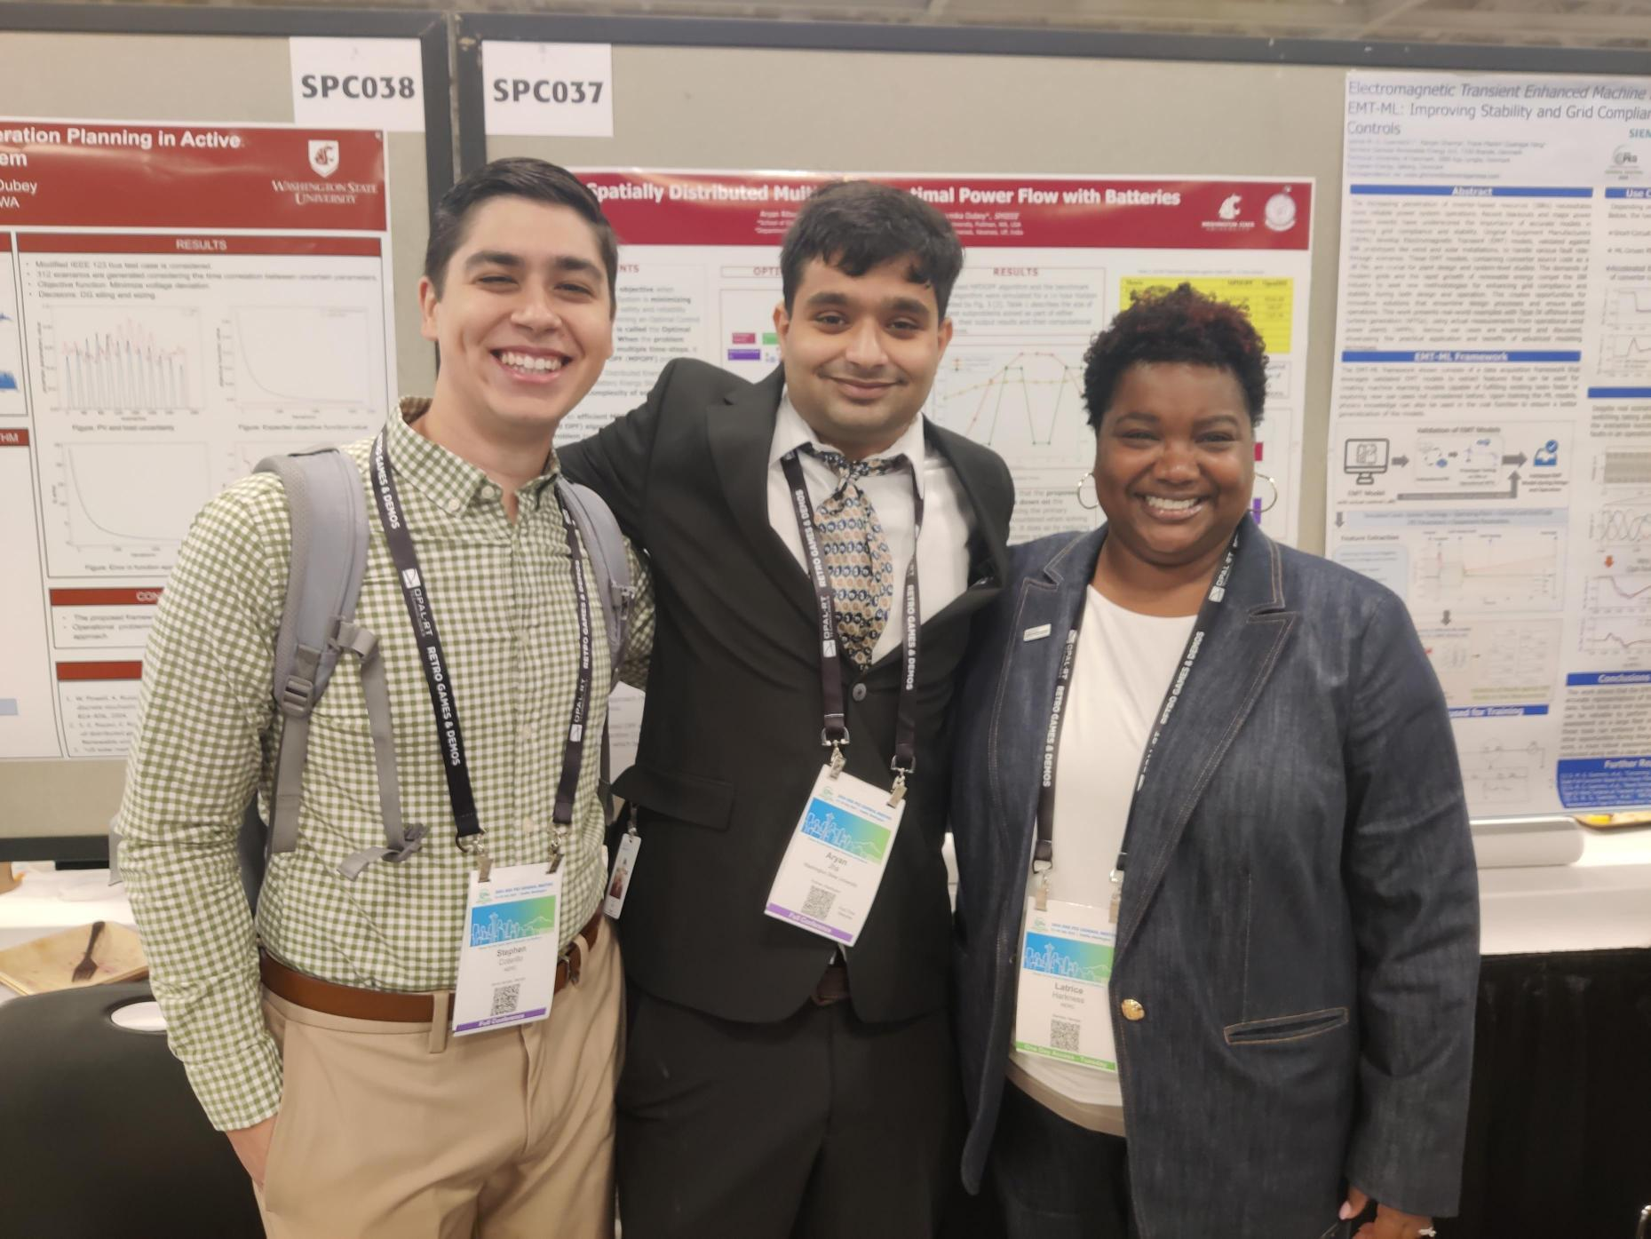
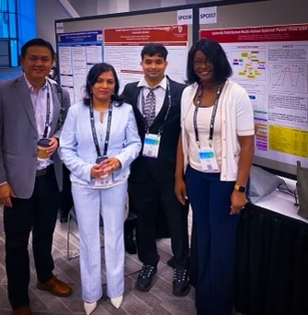
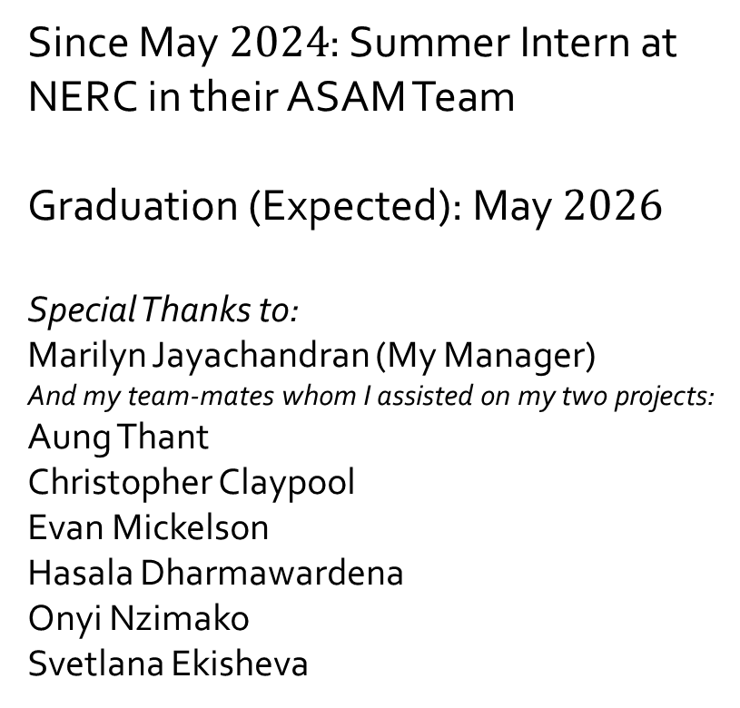
About Me
Since May $2024$: Summer Intern at NERC in their ASAM Team
Graduation (Expected): May $2026$
Special Thanks to: Marilyn Jayachandran (My Manager)
And my team-mates whom I assisted on my two projects: Aung Thant
Christopher Claypool
Evan Mickelson
Hasala Dharmawardena
Onyi Nzimako
Svetlana Ekisheva

Slide 4
Mapping GADS (Generation)
and TADS (Transmission)
Using Velocity Suite for Extreme Weather Resiliency Planning
Aryan Ritwajeet Jha
Intern for Summer 2024
Assisting Svetlana Ekisheva and Christopher Claypool
as part of
Advanced System Analytics & Modelling (ASAM)
NERC

Slide 5
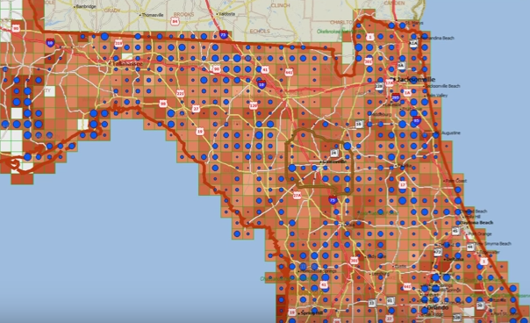
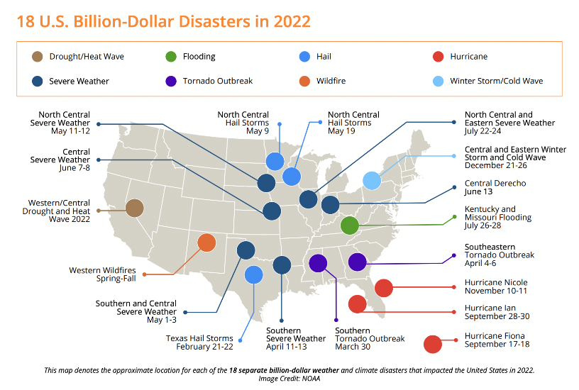
Objective for Mapping GADS and TADS
We wish to identify the transmission lines and generators most susceptible to extreme weather events
Doing so would enable us to make better planning recommendations to Transmission Owners (TOs) and Generator Owners (GOs).
Example: Mapping Energy Infrastructure Risk in Florida.
Retrieved from Prof. Thrall’s YouTube Video
Billion Dollar Weather Climate Disasters
Image from Unison Energy

Slide 6
Objective for Mapping GADS and TADS
Transmission Data
Geographical Mapping (Weather)
Generator Data
Extreme Weather Resiliency Studies
NERC has data on Bulk Power System (BPS) components including Transmission Lines (via [TADS]) and Generators (via [GADS])
By Mapping these BPS components to their geographical location we have knowledge of weather events and climate data near those locations.
GADS: Generating Availability Data System
TADS: Transmission Availability Data System

Slide 7
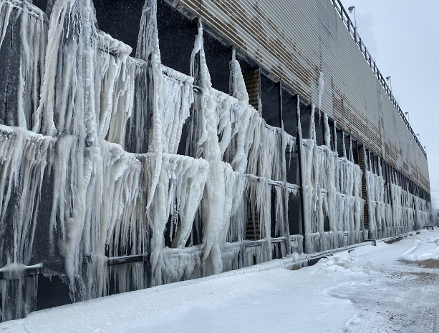
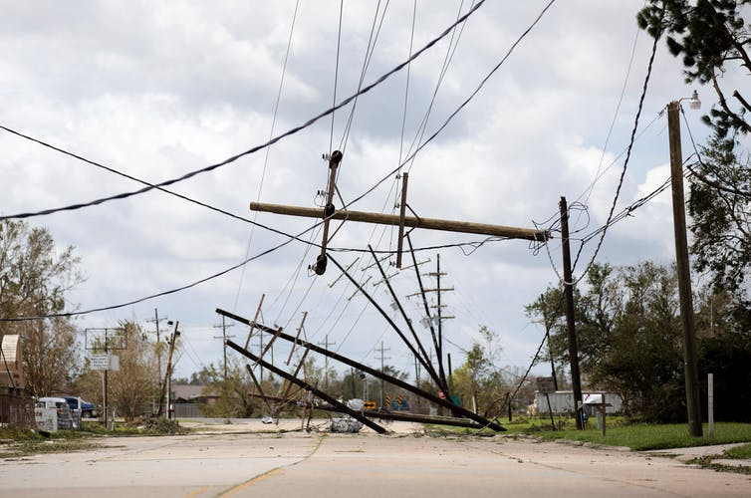
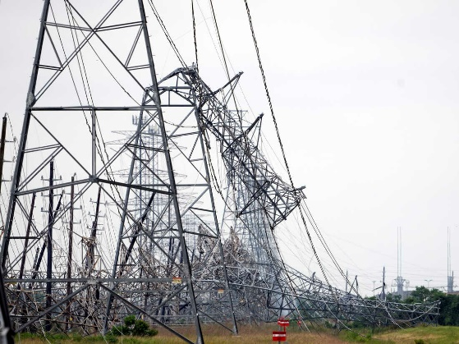
Objective for Mapping GADS and TADS
With the weather data near those BPS components, we can then determine if any outages were primarily caused due to extreme weather events.
A study correlating the extreme weather around a BPS component to the outages could be done, on similar lines as [ekisheva2024, ekisheva2023]
TADS:
Transmission Line retired that day
Local Weather:
Exceptionally high winds that day
TADS:
Generator taken off the grid that day
Local Weather:
Heavy blizzard that day
Reality (correlated)
Reality (correlated)

Slide 8




The Problem at Hand
From GADS
From Weather Stations
Generator Units
From TADS
Geographical Mapping
Weather Data
Transmission Lines
Missing Link!

Slide 9
The Workaround: Using Velocity Suite
From Velocity Suite, get a list of components which are already close to a particular weather station.
This way, both component data and its mapping is taken care of in one go.
From GADS
From Velocity Suite
Generator Units
Generator Units
From TADS
Geographical Mapping
Transmission Lines
Weather Data
Transmission Lines
Since geographical data is not collected in GADS/TADS, the generators/transmission lines are being indirectly mapped using Velocity Suite [VelocitySuite]

Slide 10



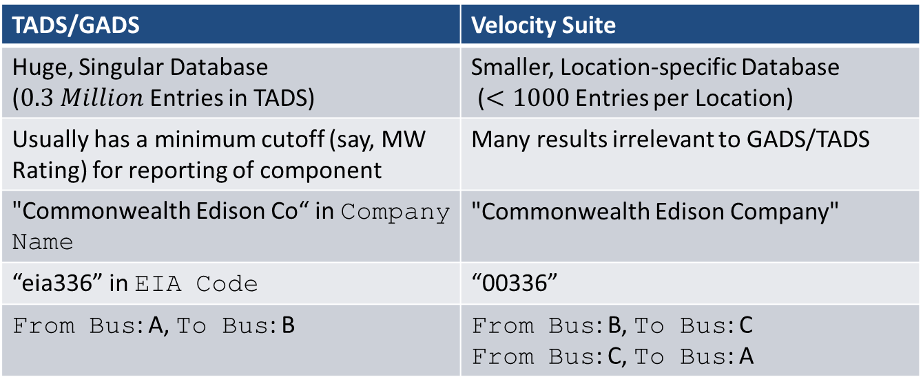
The Resulting Problem at Hand:
How to Match Components between the Two Databases?
From GADS
From Velocity Suite
Many discrepancies in reporting of data between the two databases!
Generator Units
Generator Units
Transmission Lines
Geographical Mapping
Weather Data
From TADS
TADS/GADS | Velocity Suite
Huge, Singular Database ($0.3 Million$ Entries in TADS) | Smaller, Location-specific Database ($<1000$ Entries per Location)
Usually has a minimum cutoff (say, MW Rating) for reporting of component | Many results irrelevant to GADS/TADS
"Commonwealth Edison Co“ in Company Name | "Commonwealth Edison Company"
“eia336” in EIA Code | “00336”
From Bus: A, To Bus: B | From Bus: B, To Bus: C From Bus: C, To Bus: A
Transmission Lines

Slide 11

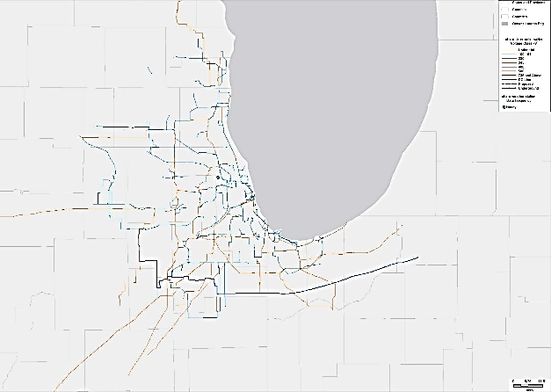
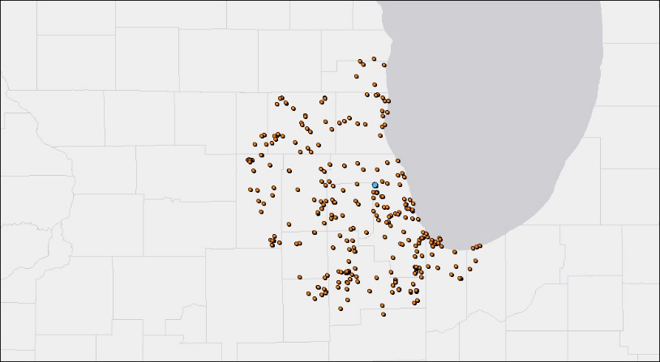
Workflow
API Calls are made to Velocity Suite along the lines of:
“List and Map all Transmission Lines which are <specific distance> from <specific weather station>*”
which will then output the qualifying transmission lines on a map and can export the TO data as an excel file.
* Weather Stations at Airports are ideal for extreme weather studies as they have the most granularity when it comes to time-series measurements related to the weather
Similarly, output if the API Call was made for Generator Units instead
An API Call for Transmission Lines rated higher than 100kV which are within 50 miles of Chicago O'Hare Weather Station
An API Call for Generator Plants which are within 50 miles of Chicago O'Hare Weather Station

Slide 12
Workflow:
Key Columns to Match
Python scripts parse the excel files from Velocity Suite, as well as GADS/TADS and attempt to make ‘matches’ (i.e. the same component represented by both GADS/TADS and Velocity Suite) based on various heuristics.
If a ‘match’ is ascertained, the Rec_ID from Velocity Suite is ‘attached’ to the GADS/TADS data, so that for future cases, we have an approximate geographical location (nearest weather station) of that BPS components
From GADS
From Velocity Suite
Rec_ID
Rec_ID
EIA Code
EIA Code
State
Generator Units
Plant Name
State
Plant Name
Generator Units
From TADS
Geographical Mapping
Weather Data
FromBus, ToBus
Rec_ID
Company Name
kV Rating
FromBus, ToBus
Transmission Lines
Company Name
Transmission Lines
kV Rating

Slide 13
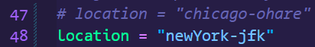
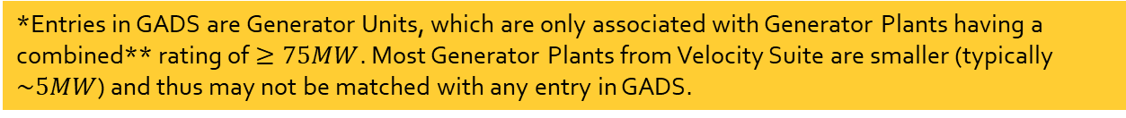
High-level Workflow for Mapping GADS
via Velocity Suite Generator Plants
Location 1: Chicago O’Hare
*Entries in GADS are Generator Units, which are only associated with Generator Plants having a combined** rating of $≥75MW$. Most Generator Plants from Velocity Suite are smaller (typically $\sim 5MW$) and thus may not be matched with any entry in GADS.
Parse Velocity Suite Data (Generator Plants)
Ascertain US States
Remove entries without EIA Codes [eia]
Parse GADS Data
Filter based on the US States from Velocity Suite
Remove entries without EIA Codes
Create a Table of Matches
Match between GADS and VS based on same EIA Code values
Attach the `Rec_ID` from VS into the table.
Now we have a table of generators whose geographical location we know
Data
Generator Plants from GADS mapped** | 25
Generator Units from GADS mapped | 126
Location 2: New York JFK
Data
Generator Plants from GADS mapped** | 66
Generator Units from GADS mapped | 266
Performing the same analysis for a different location is as easy as changing a single line of code.
** Combined Rating here is taken as the sum of Cancelled/Mothballed/Operating/Planned/Retired Cap MW ratings. Several plants have been found to have their only non-zero values in the Cancelled/Retired categories (i.e. they are basically out of operation).

Slide 14
High-level Workflow for Mapping GADS
via Velocity Suite Generator Units
On similar lines as the Generator Plants from Velocity Suite, Generator Units from Velocity Suite were also matched with the GADS Units, with some small adjustments in the workflow, and identical results were obtained.
Parse Velocity Suite Data (Generator Plants)
Ascertain US States
Remove entries without EIA Codes [eia]
Parse GADS Data
Filter based on the US States from Velocity Suite
Remove entries without EIA Codes
Create a Table of Matches
Match between GADS and VS Units based on same EIA Code values
Attach the Rec_ID from VS into the table.
Now we have a table of generators whose geographical location we know
Parse Velocity Suite Data (Generator Units)
Match Plant Names between VS Plants and VS Units
Map the EIA and Rec_ID entries from VS Plants onto the VS Units

Slide 15
High-level Workflow for Mapping TADS
via Velocity Suite Transmission Lines
Location 1: Chicago O’Hare
Entries in TADS are for transmission lines rated at a voltage $≥100kV$.
Parse Velocity Suite Data (Transmission Lines)
Ascertain Company Names
Parse TADS Data (Transmission Lines)
(Ideally) Filter based on the Company Names from Velocity Suite
Create a Table of Matches
Match between TADS and VS based on same unordered pair of (fromBus, toBus)
Attach the `Rec_ID` from VS into the table.
Now we have a table of transmission lines whose geographical location we know
Filter transmission lines below rating of $100kV$
Filter transmission lines below rating of 100𝑘𝑉
Data
Transmission Lines from TADS mapped** | 127
Location 2: New York JFK
Data
Transmission Lines from TADS mapped** | 111
** Mapping was done based on exactly matching unordered (fromBus, toBus) tuples. Many potential matches were lost because of inconsistent naming of transmission lines and even operating companies between the two databases. Overall careful manual labour (in mapping company names and bus names) required for mapping more TADS transmission lines.

Slide 16
Summary and Future Work: Automated the process of mapping BPS components. The output can now be used for extreme weather resiliency analysis when coupled with weather data. A little manual effort (such as ensuring consistency in company names) goes a long way in the analysis. So far only ‘exact’ matches were made. Future work could include making inexact, ‘fuzzy’ matches to capture potential matches left out due to data entry inaccuracies. If GADS/TADS data collection could also include some sort of approximate geographical index, it would greatly assist in this analysis.

Slide 17
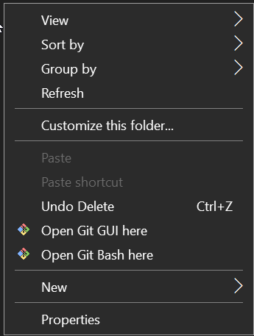
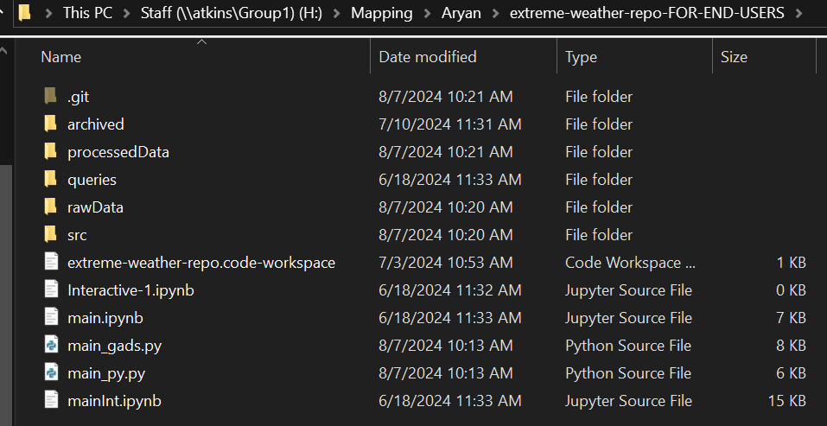
Workflow
Repo Handling if You Prefer Version Control like GitHub
The codebase including input and output excel files may be found in the NERC Staff Directory: H:\Mapping\Aryan
Have Git Bash [GitBash] installed (for running terminal commands)
Navigate to the directory H:\Mapping\Aryan\extreme-weather-repo-FOR-END-USERS
Open Git Bash in the directory (<Right Click in the directory> -> Open Git Bash here)
2
3

Slide 18
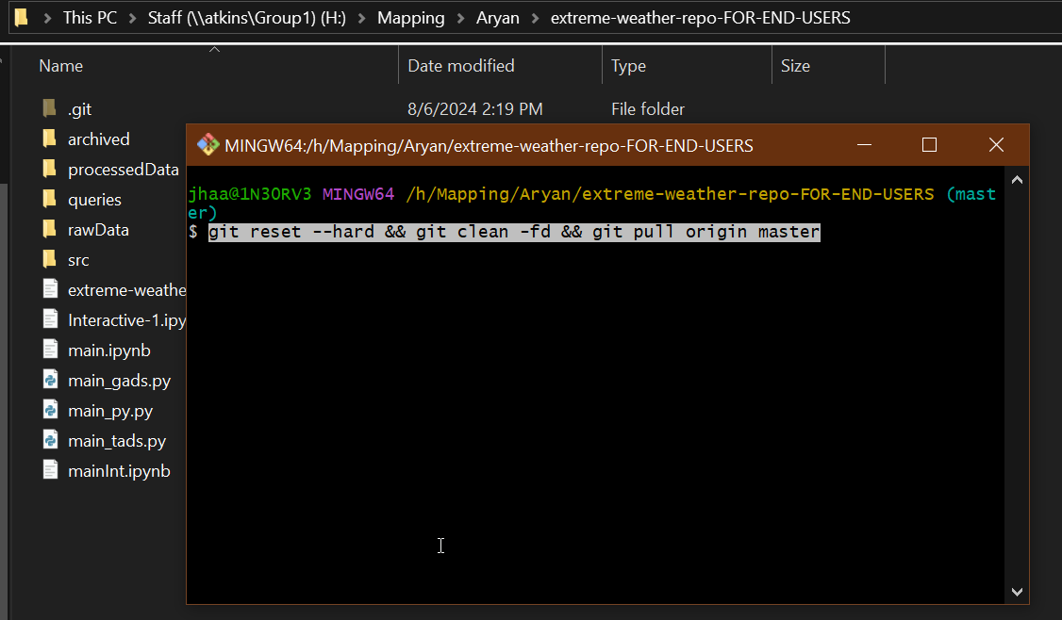
Workflow
Repo Handling if You Prefer Version Control like GitHub
Run the command: git reset --hard && git clean -fd && git pull origin master
After several minutes*, your directory is now up to date with the latest uploaded changes (Note that the actual directory with all the changes is the ‘bare’ repository extreme-weather-repo, even if it may look mostly empty). Running the command ‘extracts’ the contents of extreme-weather-repo into extreme-weather-repo-FOR-END-USERS
4
* It takes that long because of NERC VPN.

Slide 19
References
[TADS] Transmission Availability Data System (TADS). (2024, June 17). Retrieved from https://www.nerc.com/pa/RAPA/tads/Pages/default.aspx
[GADS] Generating Availability Data System (GADS). (2024, August 07). Retrieved from https://www.nerc.com/pa/RAPA/gads/Pages/GeneratingAvailabilityDataSystem-(GADS).aspx
[ekisheva2024] Svetlana Ekisheva, Christopher Claypool, Marilyn Jayachandran, Mark G. Lauby, Weather resilience of transmission system in Florida measured and tracked with detailed outage and weather data, the 18th International conference on Probabilistic Methods Applied to Power Systems (PMAPS), 2024 (to be published).
‪[ekisheva2023] Ekisheva, S., Pratt, D. K., Kachadurian, M., Martin, W. G., Norris, J., & Dobson, I. . Grid Restoration After Extreme Weather Events. 2023 IEEE PES Innovative Smart Grid Technologies Europe (ISGT EUROPE). IEEE. doi: 10.1109/ISGTEUROPE56780.2023.10407350
[VelocitySuite] Velocity Suite: The premier analytical source for energy information. (2024, January 22). Retrieved from https://www.hitachienergy.com/us/en/products-and-solutions/energy-portfolio-management/market-intelligence-services/velocity-suite

Slide 20
References
[GitBash] Git - Downloading Package. (2024, August 07). Retrieved from https://git-scm.com/download/win
[eia] Homepage - U.S. Energy Information Administration (EIA). (2024, August 07). Retrieved from https://www.eia.gov

Slide 21
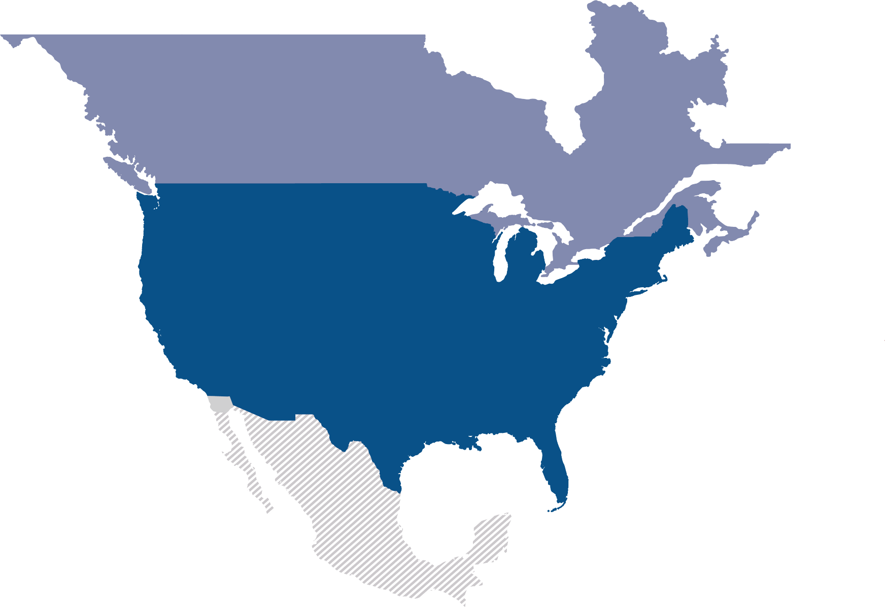
Questions and Answers

Slide 22
System Strength Overview
Aryan Ritwajeet Jha
Intern (Summer 2024)
Advanced System Analytics & Modelling (ASAM)
NERC

Slide 23
System Strength [AEMO-SS-Explained]
AEMC: “System strength is a characteristic of an electrical power system that relates to the size of the change in voltage following a fault or disturbance on the power system.”

Slide 24
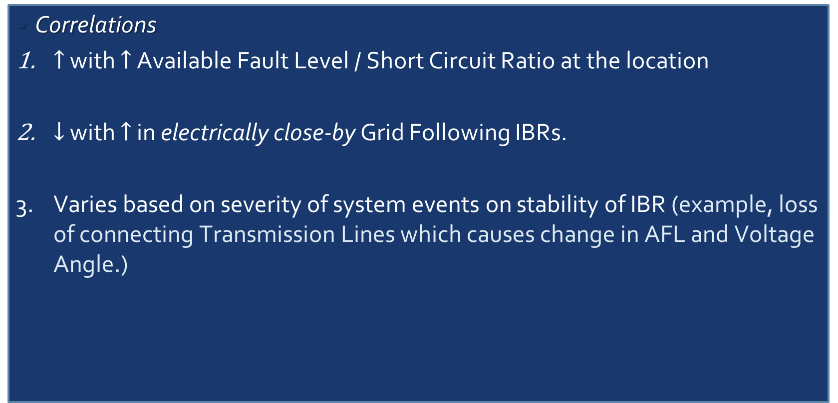
System Strength [AEMO-SS-Explained]
Correlations
$↑$ with $↑$ Available Fault Level / Short Circuit Ratio at the location
$↓$ with $↑$ in electrically close-by Grid Following IBRs.
Varies based on severity of system events on stability of IBR (example, loss of connecting Transmission Lines which causes change in AFL and Voltage Angle.)

Slide 25
Objective
With the greatly expanded share of renewable in power generation, IBRs along with other components and new control schemes are being used in the modern power grid at an unprecedented scale.
Issues at various scales are being observed, which may be at least partially associated with the current implementation of IBRs [odessa22, southtexas24]
We know the symptoms, but we don’t know a systematic diagnosis. So, people have come up with the concept System Strength which will help investigate and fix these symptoms (ideally before they ever even occur).

Slide 26
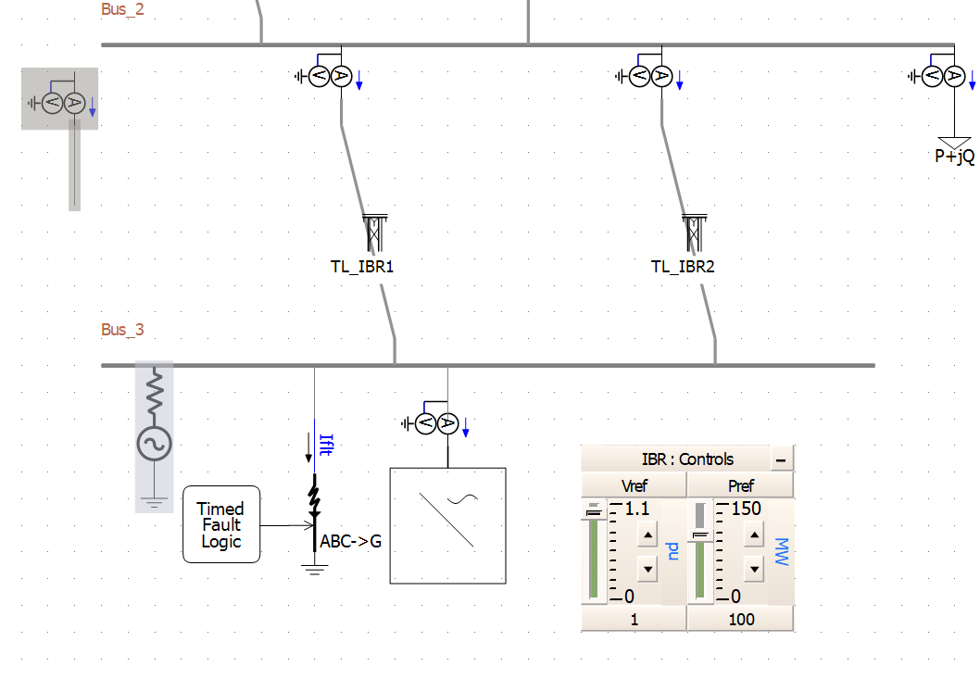
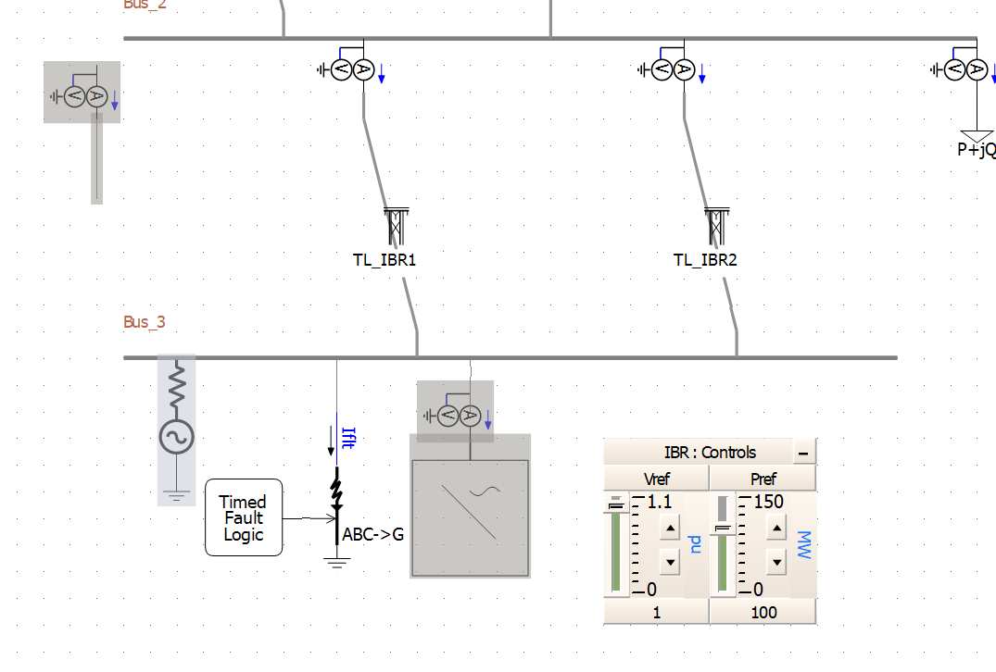
$2.3$ System Strength [AEMO-SS-Explained]
Remedial Response (‘Do No Harm’ Policy)
Before connecting your IBR to the grid, check if it will decrease the System Strength.

Slide 27
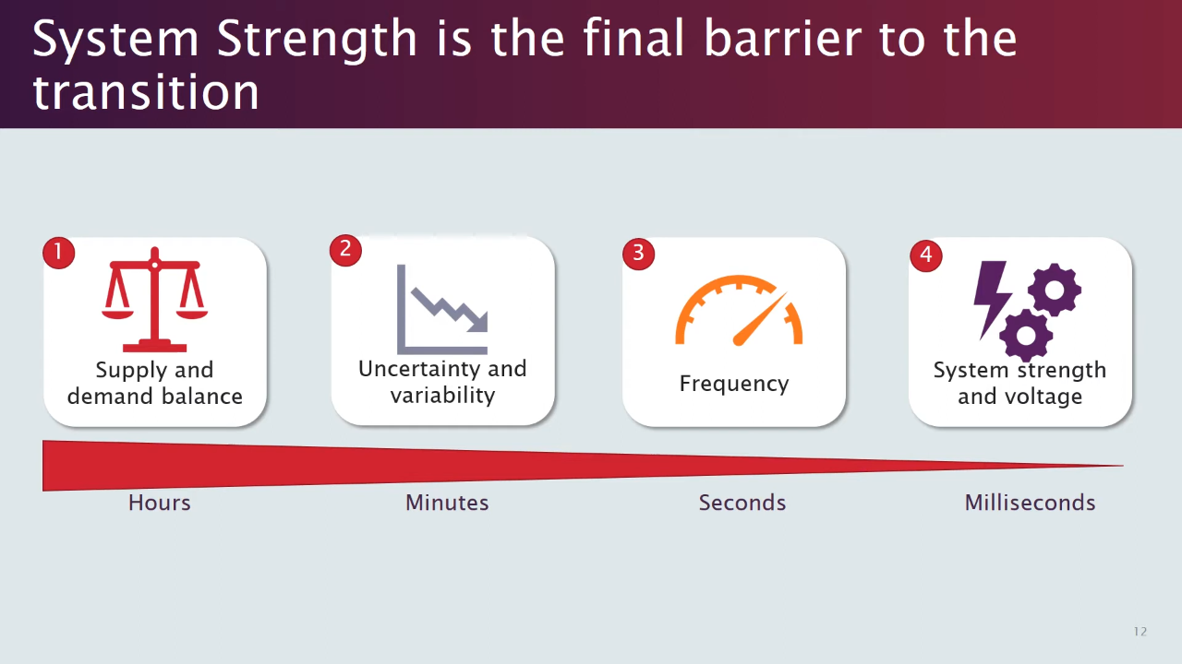
System Strength - Motivation
[session01]

Slide 28

System Strength - Motivation
[session01]

Slide 29
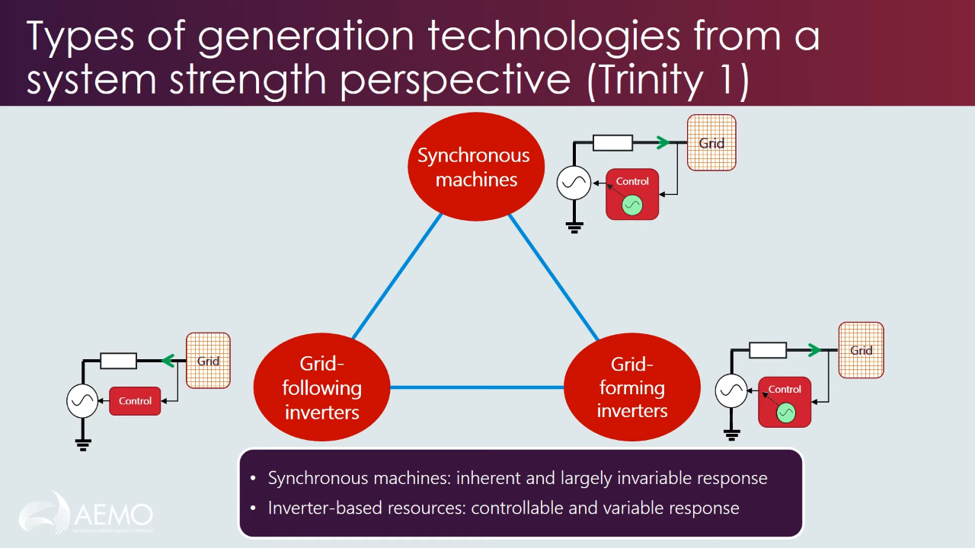
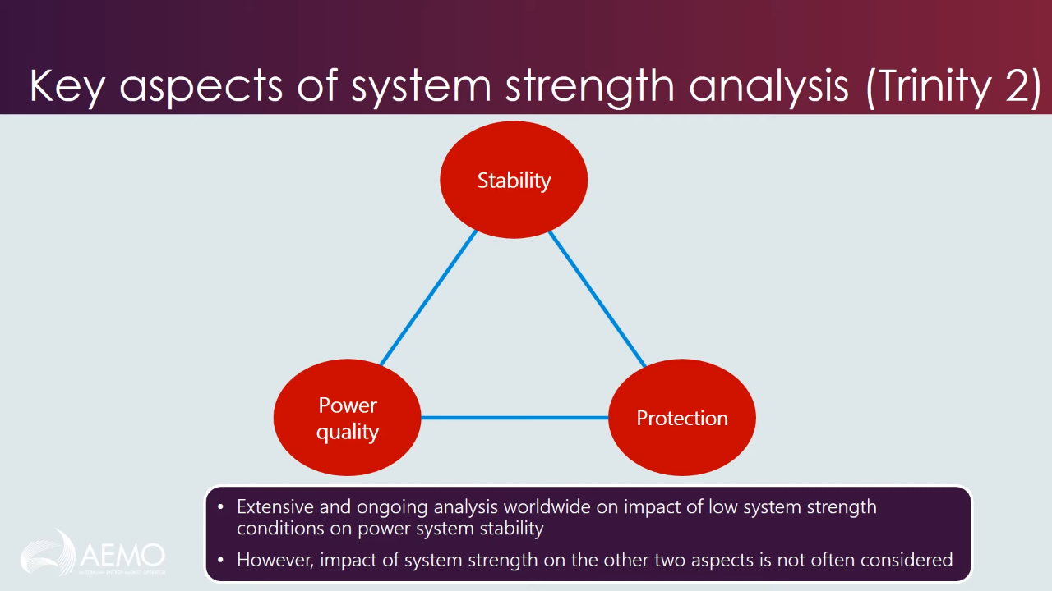
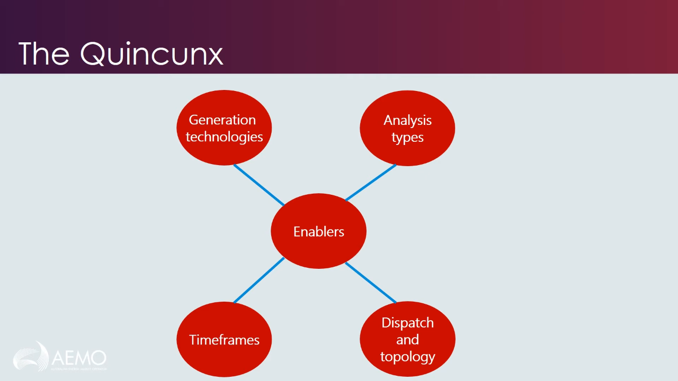
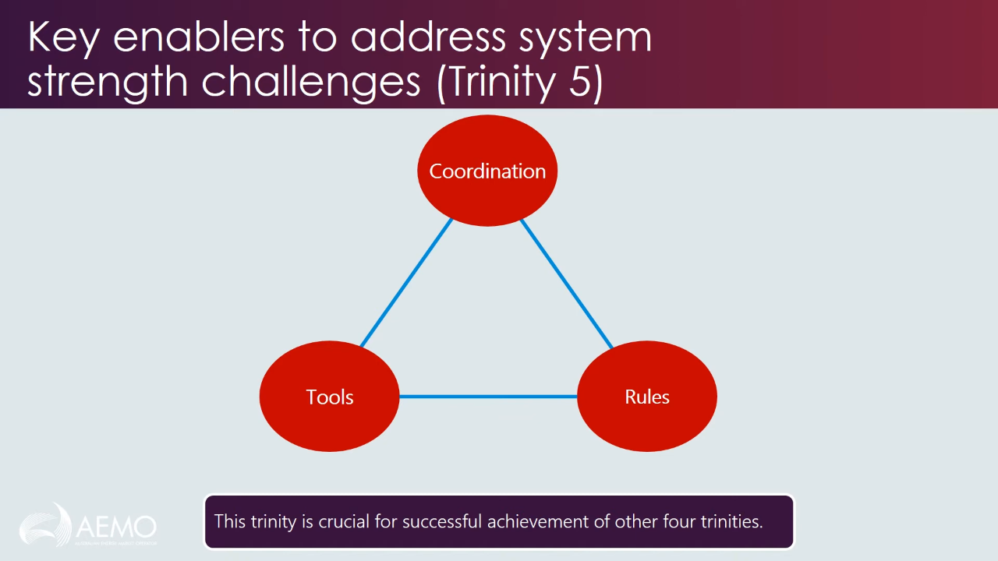
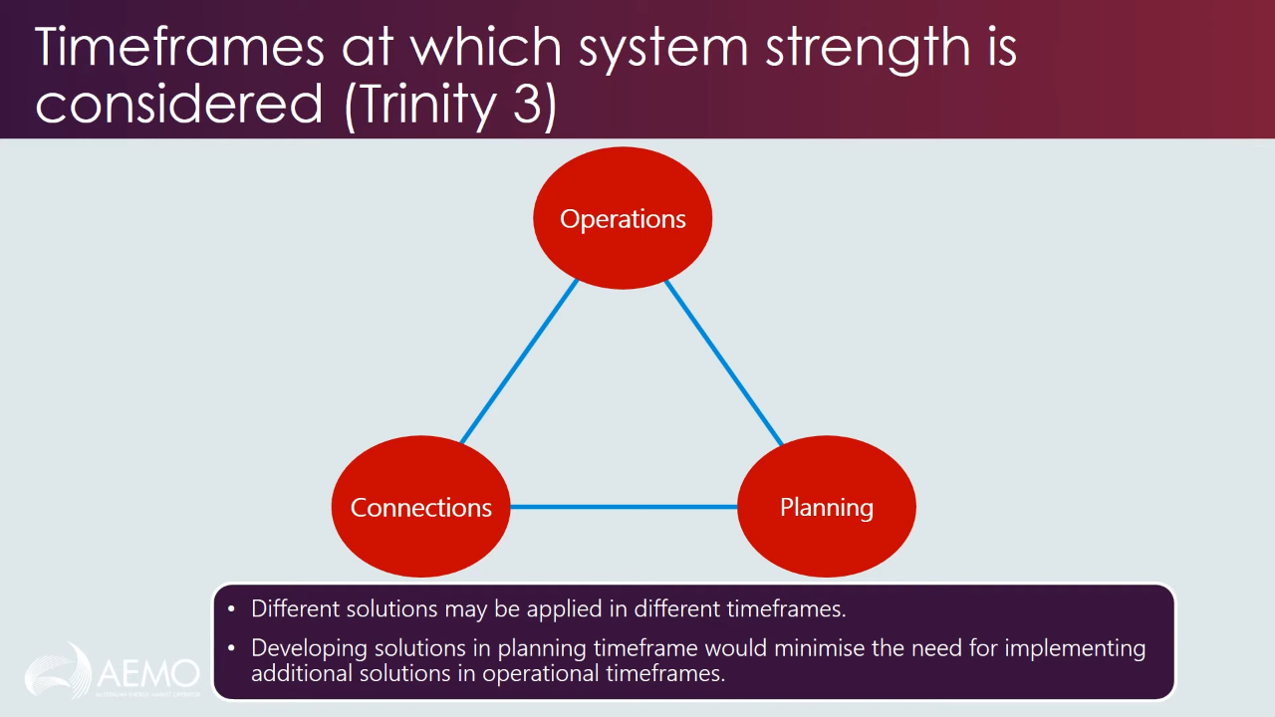
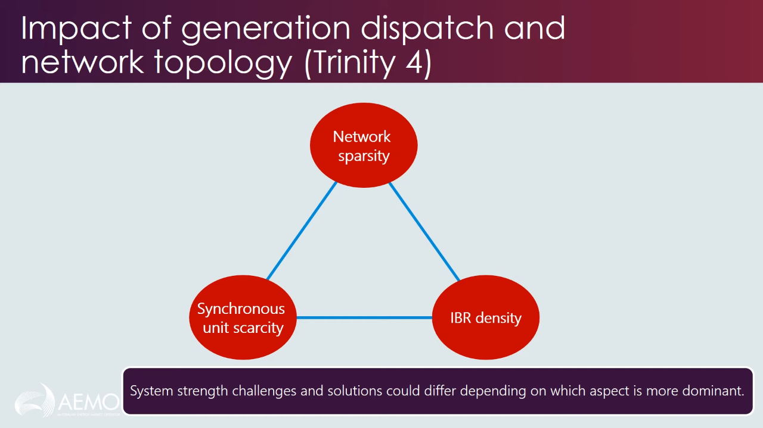
System Strength - Classification
Babak Badrzadeh from AEMO has classified System Strength into five aspects (a ‘quincunx’ : set of five).
Each aspect itself is a trinity of approaches.
[session01]

Slide 30
System Strength - Classification
Generation Technologies
[session01]

Slide 31
System Strength - Classification
Analysis Types
[session01]

Slide 32
System Strength - Classification
Timeframes
[session01]

Slide 33
System Strength - Classification
Dispatch and Topology
[session01]

Slide 34
System Strength - Classification
Key Enablers
[session01]

Slide 35
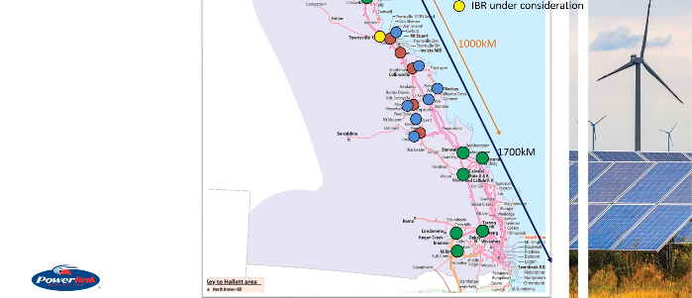
Industry Example 1: GO’s ‘Do No Harm’ responsibility, PIA, FIA
Queensland (QLD) Power Grid
[session02]

Slide 36
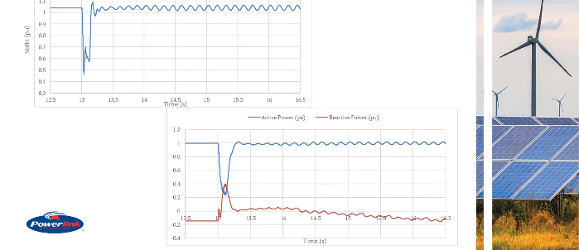
Industry Example 1: GO’s ‘Do No Harm’ responsibility, PIA, FIA
Fault simulated somewhere else in the grid, and its impact on the PoI of the proposed IBR seen.
V @ PoI without SS Adverse Impact Mitigation
P, Q @ PoI without SS Adverse Impact Mitigation
[session02]

Slide 37
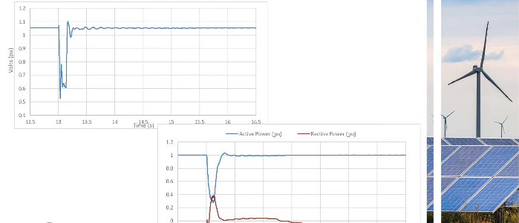
Industry Example 1: GO’s ‘Do No Harm’ responsibility, PIA, FIA
Fault simulated somewhere else in the grid, and its impact on the PoI of the proposed IBR seen.
V @ PoI with SS Adverse Impact Mitigation
P, Q @ PoI with SS Adverse Impact Mitigation
[session02]

Slide 38
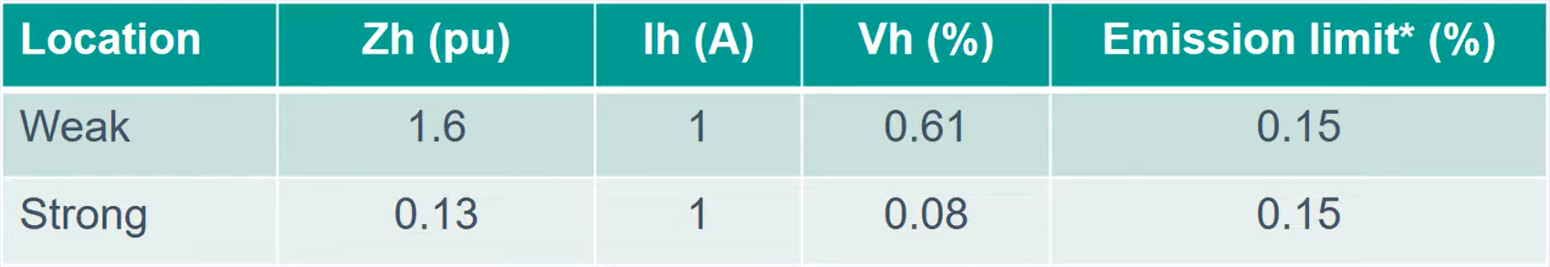
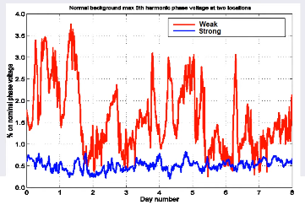

Industry Example 2: Harmonic Distortion due to Shunt Reactive Plant Switching
Weakness of SS causes high 5th harmonic distortion in Voltage
Background $5^{th}$ Harmonic Voltage – Normal Network Configuration
Weaker grids have higher harmonic impedance, which amplify even smaller harmonic currents as a bigger harmonic voltage.
Weak Grid – Violating Limits
Strong Grid – Within Limits
[session02]

Slide 39
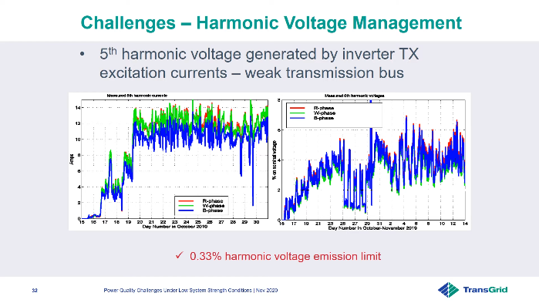
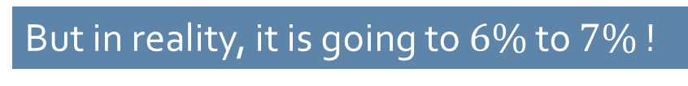
Industry Example 2 : Harmonic Distortion due to Inverter Transformer Excitation Current
Weakness of SS causes high 5th harmonic distortion in Voltage
Harmonic Voltage Emission Limit in $5^{th}$ Harmonic of Bus Voltage is set at $0.33$%
But in reality, it is going to $6\%$ to $7\%$ !
[session02]

Slide 40
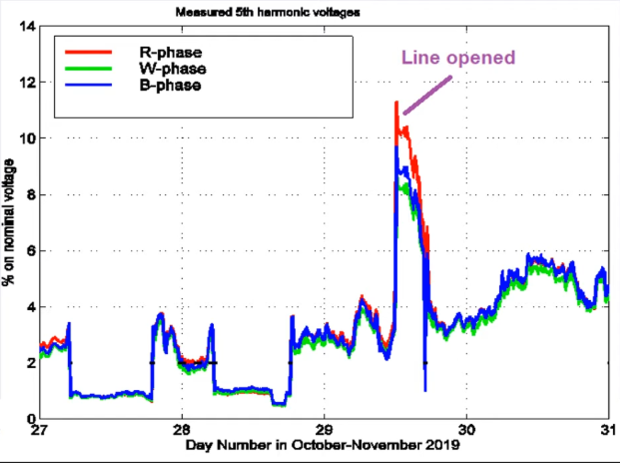
Industry Example 2 : Harmonic Distortion due to Weakened Topology
Harmonic Voltage at a weak bus shoots up when one of the connected lines is opened (network topology slightly weakened)
[session02]

Slide 41
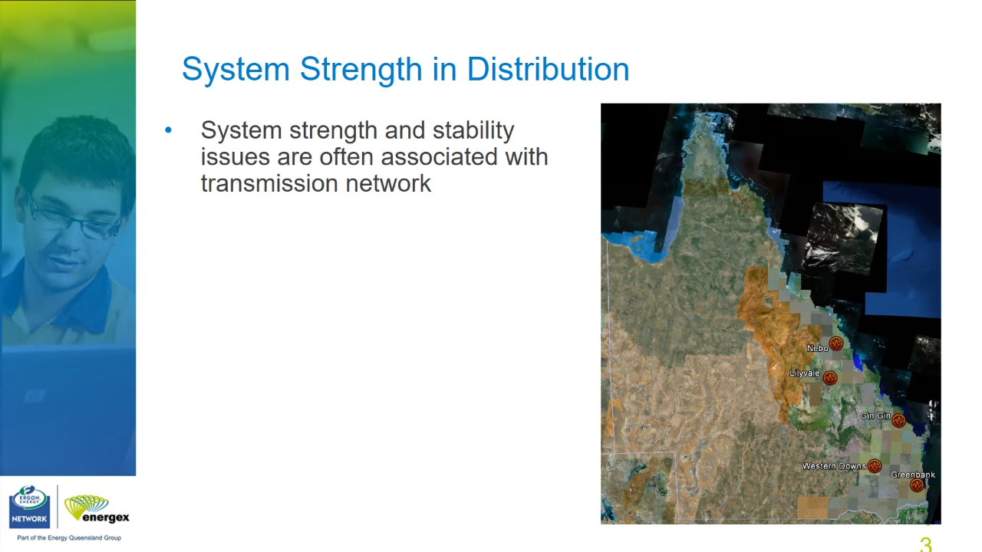
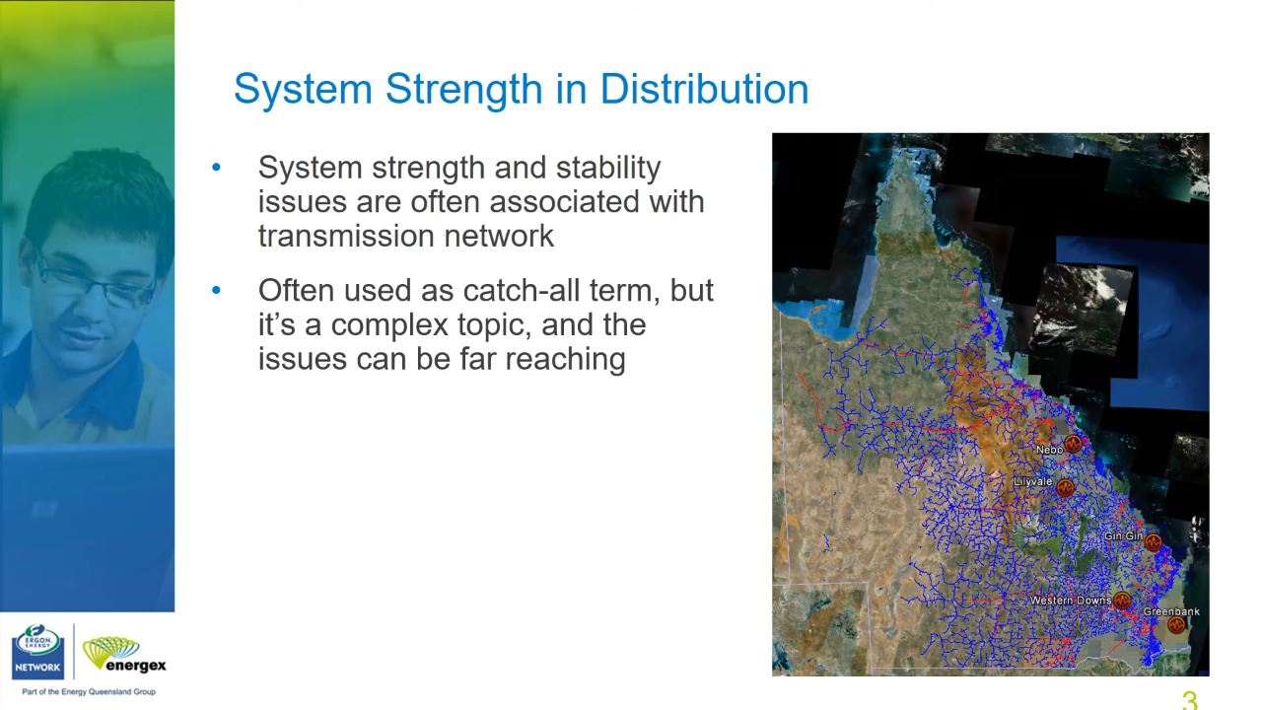
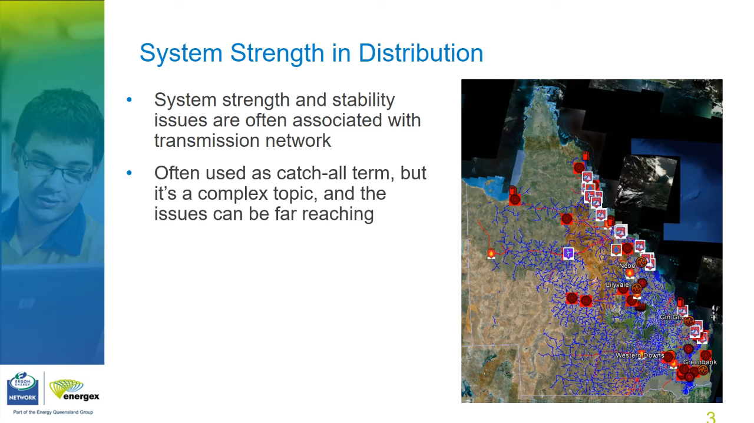
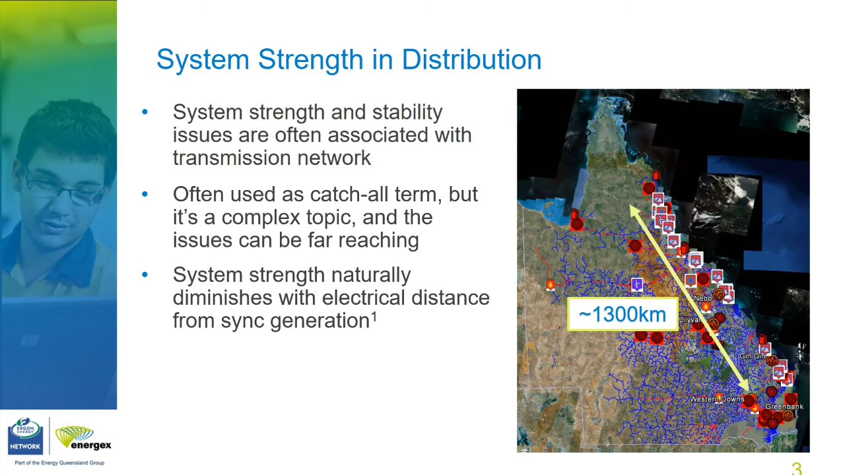
Industry Example 4
Queensland (QLD) Power Grid
A: SGs along the coast
B: A + Sub-tlines (red) and Dist lines (blue)
C: B + Renewables
C: Distance between SGs and Renewables
[session02]
System Strength naturally diminishes with electrical distance from SGs [ARENA2020]

Slide 42
System Strength [AEMO-SS-Explained]
Symptoms
Wider P, V oscillations
Prolonged V recovery
Higher Transients (deeper dips, overshoots) in V
Increased Harmonic Distortion (by-product of low SS and higher system impedances)

Slide 43
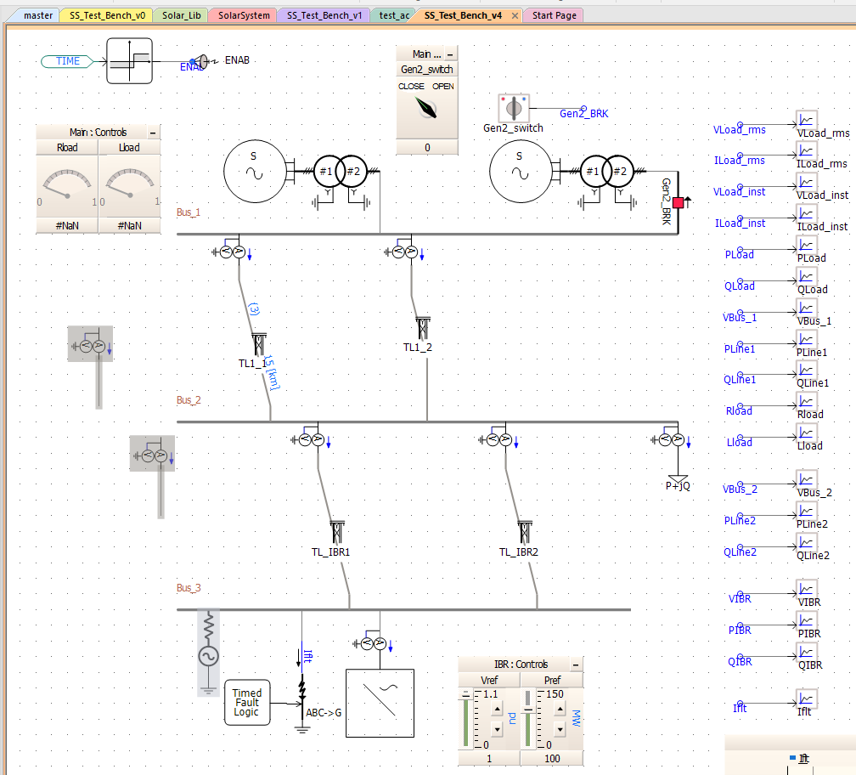
In Process: Building a Demo to demonstrate Symptoms of Weak System Strength in PSCAD

Slide 44
References
[ARENA2020] Managing System Strength During the Transition to Renewables. (2020, August 03). Retrieved from https://arena.gov.au/knowledge-bank/managing-system-strength-during-the-transition-to-renewables
[cigre-SS-YT-20] CIGRE Australia. (2024, June 21). AEMO/CIGRE System Strength Workshop Nov 2020. Youtube. Retrieved from https://www.youtube.com/playlist?list=PLwGHigN9C41BaJhk_rfXeoT8e67-m4aDX
[cigre-SS-Workshop-Iti]
[AEMO-SSIAG] AEMO | System Strength Impact Assessment Guidelines
[AEMO-SS-Explained] System Strength Explained (aemo.com.au)
[AEMO-SS-FAQ] System Strength Framework Frequently Asked Questions (aemo.com.au)
[AEMO-Calculating-SS] Calculating system strength quantities in the NEM (aemo.com.au)
[cigre-SS-Brief-2021] Chair, B. B. (.- C4. 5. C. a. Z. E. (.- S. C. (2021). System Strength. CIGRE. Retrieved from https://www.cigre.org/article/GB/publications/reference-papers/system-strength

Slide 45
References
[odessa22] RSTC_Reliability_Guidelines - All Documents. (2024, June 21). Retrieved from https://www.nerc.com/comm/RSTC_Reliability_Guidelines/Forms/AllItems.aspx
[PVCurve] Contributors to Wikimedia projects. (2023, December 16). Power-voltage curve - Wikipedia. Retrieved from https://en.wikipedia.org/w/index.php?title=Power-voltage_curve&oldid=1190109767
[Quays2023] Qays, M. O., Ahmad, I., Habibi, D., Aziz, A., & Mahmoud, T. (2023). System strength shortfall challenges for renewable energy-based power systems: A review. Renewable Sustainable Energy Rev., 183, 113447. doi: 10.1016/j.rser.2023.113447
[southtexas24] South Texas Wind Events_03082024.pptx. (2024, June 21). Retrieved from https://view.officeapps.live.com/op/view.aspx?src=https%3A%2F%2Fwww.ercot.com%2Ffiles%2Fdocs%2F2024%2F03%2F06%2FSouth%2520Texas%2520Wind%2520Events_03082024.pptx&wdOrigin=BROWSELINK

